Slide 1
Watson Solution Patterns Overview Conversational BOT
Business problem
Watson value proposition
Sample demo
Key client discussion points
Qualifying the client
Elevator pitch
Solution Architecture and Bill of Materials

Slide 2







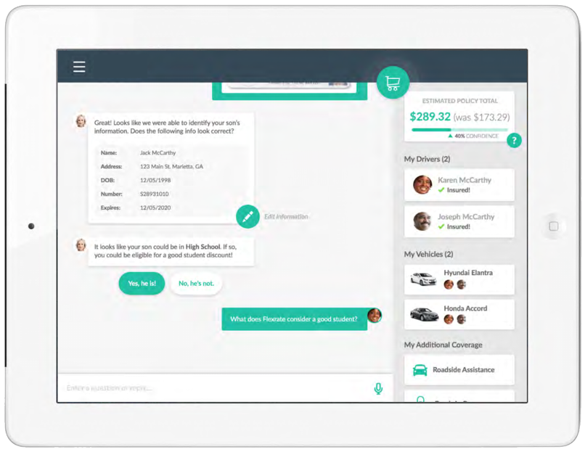
Watson Conversational BOT on a Page
Today: Contact centers are managing more channels and that makes cross- channel management more complex. Building “connective tissue” across channels is difficult and customer data can be lost. The net result is a poor customer experience and the potential for high churn.
Issues
Poor customer experience
High Cost
High Customer Churn
High Agent turnover
Agent Training costs
Channel Complexity
Mobile
Chat
Retail
Agent
Email
Forums
Web
Tomorrow: Watson Conversation BOT (Cognitive Assistant) will provide users with a consistent, unique and personal way of engaging with the organization. It can be integrated with a telephony vendor to provide warm hand-offs and
better multi-channel experiences.
Results
Contact Deflection
First Contact Resolution
Answer Consistency
Cross/up sell opportunities
Customer satisfaction
Net Promoter Score (NPS)
Mobile
Chat
Web

Slide 3




Watson Conversational BOT will drive contact center benefits on multiple levels and across multiple KPIs
1
Reduce Operating Cost
Improve Customer Satisfaction
Reduce Customers At Risk
Increase Opportunities To Sell
Quantitative KPIs
Drives digital-first interactions to optimize cost and service 24x7 inquiry response Address inquiries with improved accuracy, the first time Deliver tailored, relevant, conversational interactions regardless of channel Leverage client’s UI and channels Enable customers to interact with you from their channel of choice (Facebook, Twitter, etc.) via BOTs
Increase Contact Deflection
Decrease Average Handle Time
Improve First Contact Resolution
Increase revenue through cross sell and up sell opportunities
Decrease agent to agent transfers
2
Qualitative Drivers
Increased customer satisfaction
Customer engagement insights
Consistency of answers across channels
Increase Life time value
Net Promoter Score (NPS)

Slide 4
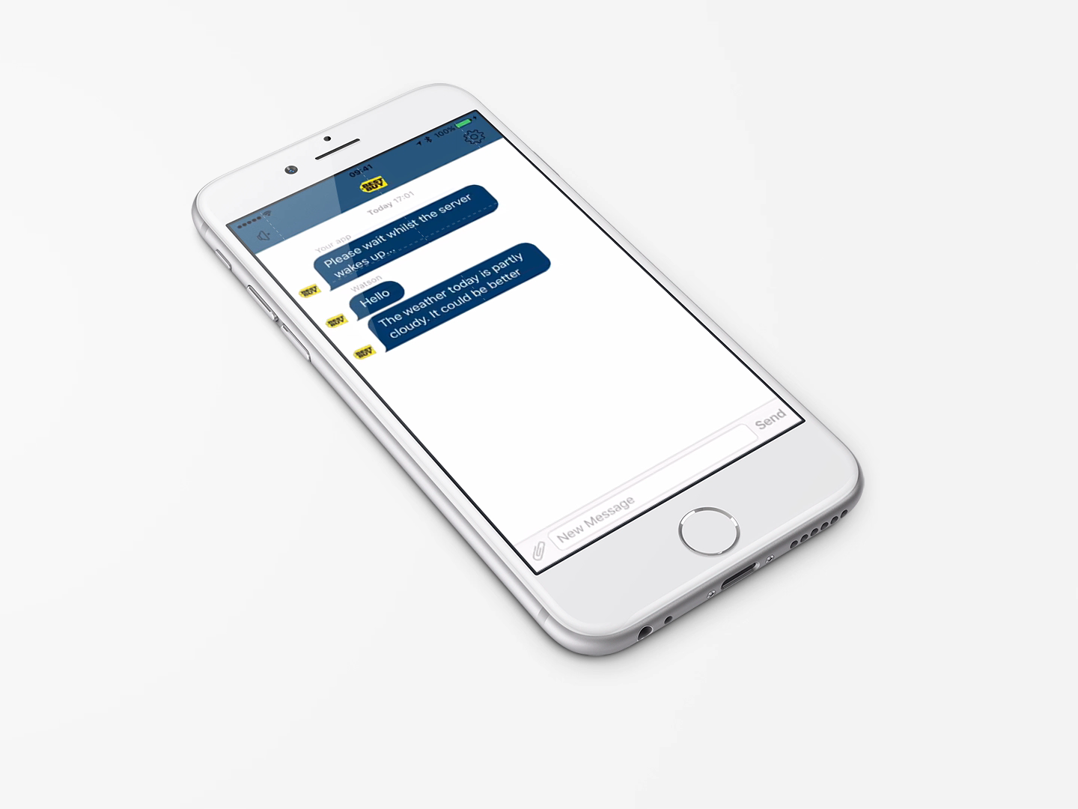
Video of the Demo

Slide 5
Watson Conversational BOT delivers consumer success; is preferred by emerging customer groups and unifies channels for consistent performance
Mobile
Chat
Retail
Agent
Email
Forums
Web
Millennial Preferred
Improved Information Sharing
Better Use of Personnel
Scalable and Flexible
Unified Metrics
In a recent 13-week test at Georgia Tech the Bot was undistinguishable from human responses and perceived as “cool” and interesting
Being able to use content and response data across channels provides better, faster response management and improves answers across all channels
BOTs handle well known question and answer patterns allowing resources to work where they are truly needed
BOTs can handle times of high demand more easily; responding to the ebb and flow of the business, with rapid, consistent and timely interactions
The questions, answers patterns, volume and trending can all be combined and viewed consistently for better OpEx and operational management.

Slide 6
A checklist for sellers to qualify the client
Key Criteria |  | Optimal Candidates Look Like:
SPONSORSHIP: |  | Vice President and C-Level executives have the best span of control to make the decisions that drive success
VISION: |  | Understanding the impact of Watson technology and processes requires a bold vision, not an incremental one
BUDGET: |  | Being able to undertake a pilot is a great place but ensuring there is plan for broader roll-out up front drives faster adoption
CHANNEL DIVERSITY: |  | Increased channels offer a greater transformation opportunity through cognitive approaches
ADOPTION EFFORTS: |  | Understanding client processes and success definitions enable development of transformational processes and metrics
CUSTOMER EXPERIENCE: |  | A Watson-driven digital transformation combines channels seamlessly with shared metrics. Delivering these requires multiple domains working on shared platforms and information
BRAND REPUTATION: |  | Companies seeking to improve reputation or maintain leadership positions are better candidates. Success occurs customer experience and innovation are on executive agendas.

Slide 7
Elevator Pitch for Conversation BOT
Watson can be self service channel for engagement with customers
Organizations are making a push to move more customer interactions to a digital channel
This Watson-enabled digital conversational BOT allows you to manage a full conversation in a digital channel because it can understand natural language, emotion, intent, and tone
The conversational BOT can also be integrated with the Telephony system to pass a conversation into the call center when business rules are triggered
A dashboard shows the classification of conversations that the organization handles
You can see that the conversations that are being classified and assessed in real time as they’re coming in
Emotional and Social tones show the distribution of conversations across those categories from cognitive psychology, this information helps inform the type of reply that can be received best
FAQs
What is the client buying?
A 1-year subscription to Watson Explorer license and Watson Developer Cloud Platform which will enable the client to develop the Conversation BOT pattern
How much does it generally cost?
$250K for 1-year subscription & 4 weeks to deploy an initial pilot
How does the solution get implemented?
There are two options:
Self-Serve: 1-week enablement session for client developers with education on the solution pattern. After which, client IT teams then develop/deploy the solution in a self-serve mode.
Professional Services: Hire system integrator to develop

Slide 8
Start NOW. Continue with intense focus and deep passion for success.
1.
Target solutions for your accounts
Review materials
Solutions Card
Seller’s Brief
Demo + Script
Customize your messaging and materials
Prepare your pitch
Practice using the demos
2.
Determine your client customization
Determine which patterns work best
Request customized demos for solutions most relevant to industry and account (SC number needed)
Determine data and content sources
3.
Conduct your meeting with confidence
Effective, well rehearsed demos (video alternatives)
Direct, relevant slides
Ability to move quickly to sales process
And please be sure to give us your feedback!

Slide 9
Solution Architecture and Bill of Materials
Watson Engagement Advisor 3.0 (till Conversation comes GA / stable)
Watson Conversation API
Watson Speech to Text
Watson Tone Analyzer
Bot Integration Framework (3rd party or custom)
Watson Retrieve & Rank* (for enhanced information retrieval)

